Slide 1
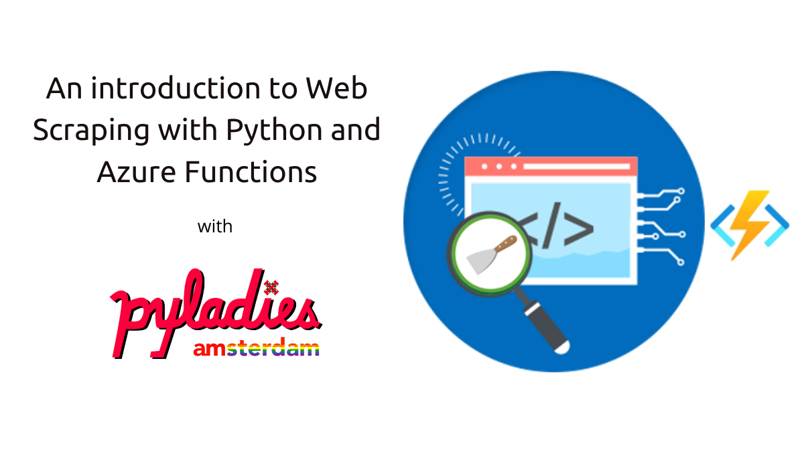

Slide 2



Hello!
I am Daniela Miranda
and I’m here because I’m passionate about Data

Slide 3
Index
1- Web Scraping (generating output)
2- Blob Storage (storing the output)
3- Wordcloud (convert output into a wordcloud)

Slide 4
Web Scraping
Common uses
Benefits
Scrapy the library
Where to store the library?

Slide 5
Common uses
Common uses of web scraping

Slide 6
Benefits
What are the benefits of web scraping?

Slide 7

Scrapy
A framework for crawling websites and extracting data
There are five main components

Slide 8
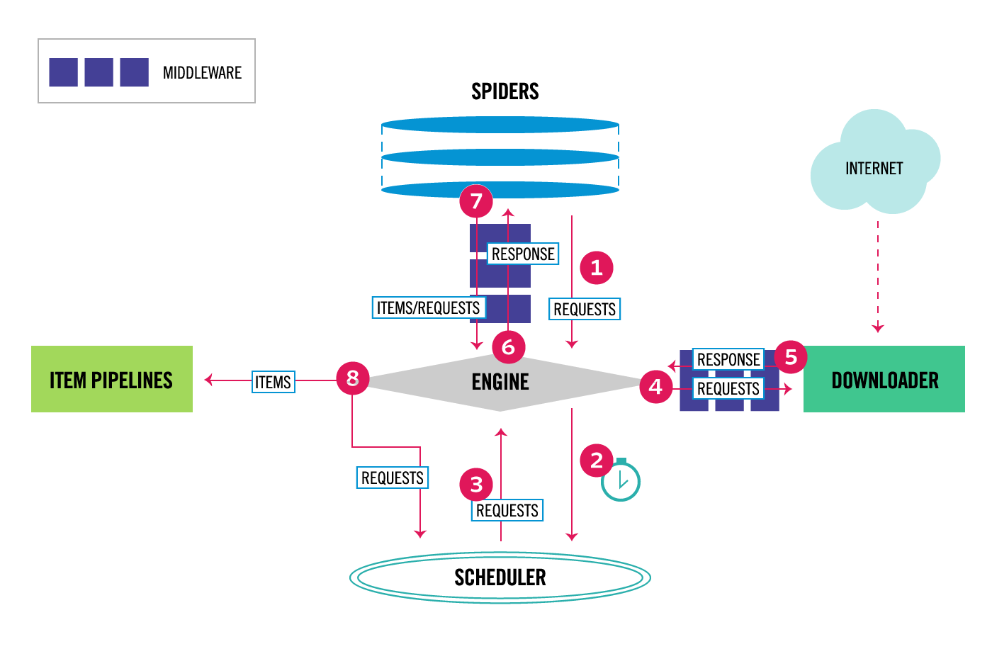

Slide 12
Notes:
Switch to Demo
Task for the attendees, add the solution to the repo : Modify the scraper

Slide 13
Storing
Textfile on local machine
Store it on a Database
What if you are DS and work on a team. You want your other teammates to see your scraped data?
One drive -> not everyone has access to it, you have to manage access
If company works in the cloud, high probability opf Azure Storage, the cheapest way to store info
Intro to blob, one type of Azure storage
Notes:
Save outcome of scrapy downloading on local machine

Slide 14
Blob Storage
What is a Blob Storage?
Working with Microsoft Azure

Slide 15
What is a Blob storage?
A

Slide 16
Microsoft Azure
Azure functions

Slide 17
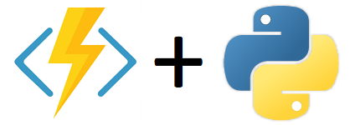
Azure functions
serverless, lightweight, language independent
“Azure functions allows you to implement you systems logic into readily available blocks of code, these code blocks are called functions.”

Slide 18
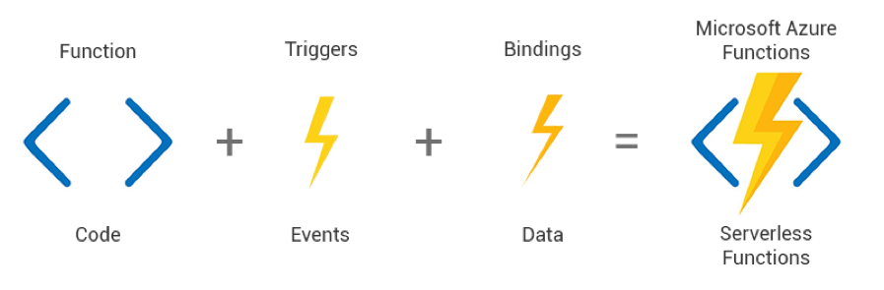
2 additional components of the function: Triggers and Bindings
Triggers: determines the way the function will execute
Bindings: determines the input and output of my function

Slide 19
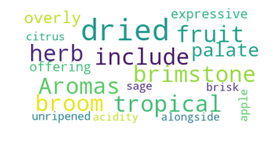
Blob storage trigger
Text file input

Slide 20
Wordcloud
What is a Wordcloud?
How to generate a Wordcloud?

Slide 21
What is a Wordcloud?
Collection of clusters of words
Basically a visualization of text data

Slide 22
How to generate a Wordcloud?
a

Slide 23

Demo Time

